Slide 1

OpenFDA Adverse Drug Prescriptions & Reactions Prediction Model
ARI KAMLANI
arikamlani.com
akamlani@gmail.com, ari.kamlani@nagra.com, @akamlani
http://github.com/akamlani/openfda

Slide 2
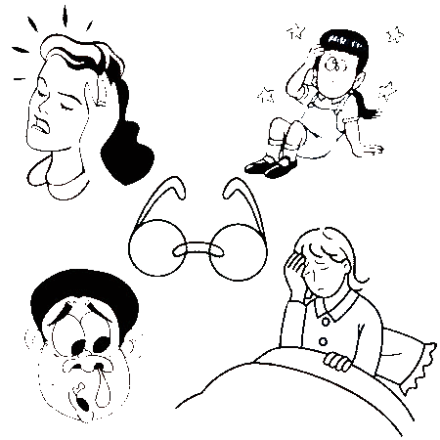

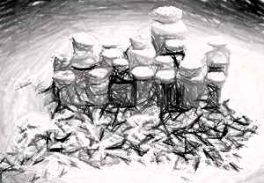
Problem
Can we help Patients avoid adverse reactions ?
Minimized Reactions from Multiple Prescribed drugs
Drug Avoidance based on High Probability of Reaction

Slide 3
Case Study
Serious Reports
Elderly Patients (Ages 65+), Patient Indication=“Hypertension”
Multiple Prescribed Drugs -> Multiple Reactions
Determine Drug Correlation and Drug/Reaction Dependency

Slide 4
OpenFDA Queries
OpenFDA Launched in Beta Summer 2014
Drug Endpoint Query
https://api.fda.gov/drug/event.json?
Parameters: api_key, search, count, limit
Requires Pagination and Queries Rate Limited
4M + Reported Records
Some records include Drug Name Normalization
Via Voluntary Reports (FDA Adverse Event Reporting System: FAERS)
JSON data not Flat (Multiple Embedded Dictionaries and Lists)
Not Able to Filter Multiple Levels (e.g. all Drugs, Reactions)

Slide 5
ML Techniques Used
Multi-Dimensional Feature Space, Multiple Possible Targets
No True Target Label -> Semi-Supervised/Unsupervised Learning
Common ML Techniques learned don’t fit
Data Munging/Filtering – Voluntary Data
Neural Networks Variants (Deep Learning)
Restricted Boltzmann Machine (RBM) – Binary Valued
Cosine Similarity Metrics

Slide 6
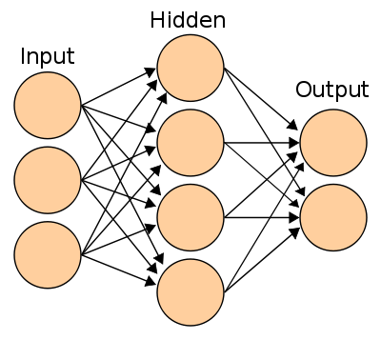
Neural Network Mappings
n_visible: {d1, d2, d3, … dn}
n_hidden: n_reactions

Slide 7
Model
Sparse Data
RBM NN
Hidden Nodes Weight Thresholds
Sample Patients + Drugs Taken
Reaction Reduction
Inter Drug Similarity
Focused Drug/Reaction

Slide 8
Stats
3000 Patient Training Records : Minimized due to Memory
4970 Visible Nodes (Drug Matrix)
2908 Hidden Nodes (Reactions)
Default Number of Epochs (10)
Training Time: < 10 Min
Hidden Node Connection Threshold: >= 2

Slide 9
Top Similar Drugs Sample
Drug
ACCUZIDE (HYDROCHLOROTHIAZIDE, QUINAPRIL)
ERYTHROCIN
FOLBEE PLUS
FUSIDATE SODIUM
METFORMINE
NOLVADEX D
HERBESSOR R
SEISHOKU (SODIUM CHLORIDE) (SODIUM CHLORIDE)
BINORAC
PROPRANOLOL

Slide 10
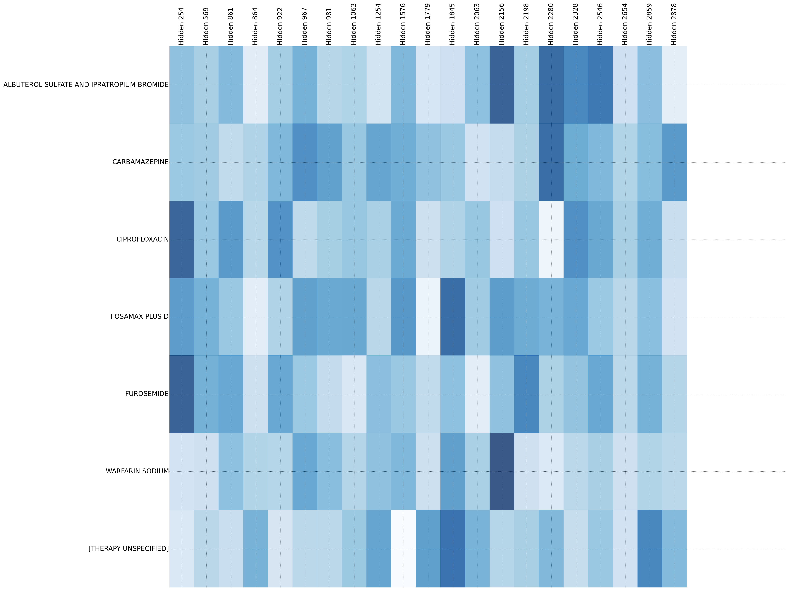
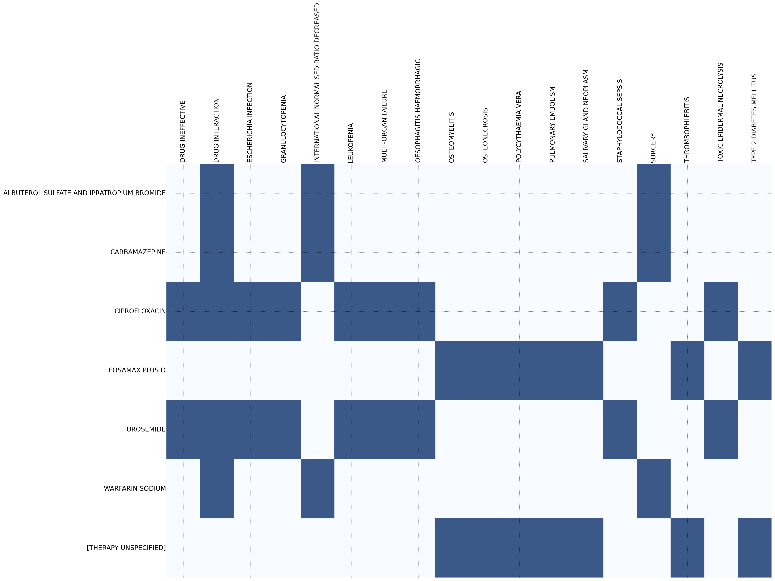
Visualization: Minimized Reactions from Drug Connection Weights

Slide 11
Lessons Learned
Choose a simpler dataset and Project Idea!
Non-Tabular data format creates more difficulty
Dealing with Multidimensional data (Input + Output) is difficult
Even small Neural Networks can take a long time to train
Sparse Matrixes and Memory are important!
Minimization problem to apply more traditional ML Aspects

Slide 12
Next Steps
Use of Drug Harmonization
Further Drug Separation and Insights
Chemical Structure
Physiologic Effect
Dosage Information
Neural Networks
Theano Package
Scaling
Apply to other Case Studies and Larger datasets
Multiple Clusters
Account for Memory

Slide 13

Q/A

